Slide 1
Trap analysis Validity of Hurkx trap-assisted tunneling
Student : Ying-Lun Kao
Advisor : Dr. Hao-Hsiung Lin
Date : 108. 09. 25

Slide 2
Abstract
Trap-assisted tunneling 關鍵在於 tunneling probability。已知三種 Field-enhanced thermal emission model，前兩種結果相同，但與第三種差異在 pre-factor。第一種為 Hurkx 使用的 Effective-mass approximation，據我推測可能僅適用足夠小的材料跨壓。第二種為 Korol 針對深能井所使用的 Green‘s function approach。第三種為 W. W. Anderson 使用的 Oppenheimer approach，適用深能井。由於時間有限，目前僅分析 Hurkx validity，並對不同跨壓範圍擬合分析，討論可能誤差來源。
針對 InP，不論跨壓都有不錯 IV 擬合，並有深能井 $E_{Ti,InP}≈0.06\left(eV\right)$且 $m_{t}≈0.01m_{e}$，文獻值約$0.08\sim 0.6m_{e}$。針對 InGaAs，不論跨壓皆有不錯 IV 擬合，並能驗證羅博士提供的 APD 濃度，成功解釋擊穿電流之緩慢上升現象，$E_{Ti,InGaAs}≈0.17\left(eV\right)$，其 SRH lifetime 也大致保有 $τ≈τ_{300}{\left(T/300\right)}^{α}$ 級數規律，等效質量約 $0.0025m_{e}$，文獻值約$0.03m_{e}$。

Slide 3
Outline
SRH recombination model
Field-enhanced thermal emission rate model
Curve fitting method
Fitting results

Slide 4
SRH recombination model
Approximation of SRH recombination rate
SRH recombination current equation

Slide 5
Pure SRH recombination rate
$$p_{1}=n_{i}exp\left(\frac{E_{i}−E_{t}}{kT}\right);$$
$$n_{1}=n_{i}exp\left(\frac{E_{t}−E_{i}}{kT}\right);$$
$$p=n_{i}exp\left(\frac{E_{i}−E_{Fp}}{kT}\right);$$
$$n=n_{i}exp\left(\frac{E_{Fn}−E_{i}}{kT}\right)$$
$$R_{SRH}=\frac{np−n_{i}^{2}}{τ_{p}\left(n+n_{1}\right)+τ_{n}\left(p+p_{1}\right)}$$
$$=\frac{n_{i}^{2}exp\left(\frac{E_{Fn}−E_{Fp}}{kT}\right)−n_{i}^{2}}{τ_{p}\left[n_{i}exp\left(\frac{E_{Fn}−E_{i}}{kT}\right)+n_{i}exp\left(\frac{E_{t}−E_{i}}{kT}\right)\right]+τ_{n}\left[n_{i}exp\left(\frac{E_{i}−E_{Fp}}{kT}\right)+n_{i}exp\left(\frac{E_{i}−E_{t}}{kT}\right)\right]}$$
$$=\frac{n_{i}\left[exp\left(\frac{E_{Fn}−E_{Fp}}{kT}\right)−1\right]}{τ_{p}\left[exp\left(\frac{E_{Fn}−E_{i}}{kT}\right)+exp\left(\frac{E_{t}−E_{i}}{kT}\right)\right]+τ_{n}\left[exp\left(\frac{E_{i}−E_{Fp}}{kT}\right)+exp\left(\frac{E_{i}−E_{t}}{kT}\right)\right]}$$

Slide 6
$$×exp\left(−\frac{E_{Fn}−E_{Fp}}{2kT}\right)/exp\left(−\frac{E_{Fn}−E_{Fp}}{2kT}\right)$$
$$R_{SRH}=\frac{n_{i}\left[exp\left(\frac{E_{Fn}−E_{Fp}}{kT}\right)−1\right]}{τ_{p}\left[exp\left(\frac{E_{Fn}−E_{i}}{kT}\right)+exp\left(\frac{E_{t}−E_{i}}{kT}\right)\right]+τ_{n}\left[exp\left(\frac{E_{i}−E_{Fp}}{kT}\right)+exp\left(\frac{E_{i}−E_{t}}{kT}\right)\right]}$$
$$=\frac{n_{i}\left[exp\left(\frac{E_{Fn}−E_{Fp}}{2kT}\right)−exp\left(−\frac{E_{Fn}−E_{Fp}}{2kT}\right)\right]}{\begin{aligned}τ_{p}\left\{exp\left[\frac{\left(E_{Fn}+E_{Fp}\right)/2−E_{i}}{kT}\right]+exp\left(−\frac{E_{Fn}−E_{Fp}}{2kT}\right)exp\left(\frac{E_{t}−E_{i}}{kT}\right)\right\} \\ +τ_{n}\left\{exp\left[\frac{E_{i}−\left(E_{Fp}+E_{Fn}\right)/2}{kT}\right]+exp\left(−\frac{E_{Fn}−E_{Fp}}{2kT}\right)exp\left(\frac{E_{i}−E_{t}}{kT}\right)\right\}\end{aligned}}$$
$$=\frac{n_{i}}{\sqrt{τ_{p}τ_{n}}}\frac{2sinh\left(\frac{E_{Fn}−E_{Fp}}{2kT}\right)}{\begin{aligned}\sqrt{\frac{τ_{p}}{τ_{n}}}\left\{exp\left[\frac{\left(E_{Fn}+E_{Fp}\right)/2−E_{i}}{kT}\right]+exp\left(−\frac{E_{Fn}−E_{Fp}}{2kT}\right)exp\left(\frac{E_{t}−E_{i}}{kT}\right)\right\} \\ +\sqrt{\frac{τ_{n}}{τ_{p}}}\left\{exp\left[\frac{E_{i}−\left(E_{Fp}+E_{Fn}\right)/2}{kT}\right]+exp\left(−\frac{E_{Fn}−E_{Fp}}{2kT}\right)exp\left(\frac{E_{i}−E_{t}}{kT}\right)\right\}\end{aligned}}$$

Slide 7
$$R_{SRH}=\frac{n_{i}}{\sqrt{τ_{p}τ_{n}}}\frac{2sinh\left(\frac{E_{Fn}−E_{Fp}}{2kT}\right)}{\begin{aligned}\sqrt{\frac{τ_{p}}{τ_{n}}}\left\{exp\left[\frac{\left(E_{Fn}+E_{Fp}\right)/2−E_{i}}{kT}\right]+exp\left(−\frac{E_{Fn}−E_{Fp}}{2kT}\right)exp\left(\frac{E_{t}−E_{i}}{kT}\right)\right\} \\ +\sqrt{\frac{τ_{n}}{τ_{p}}}\left\{exp\left[\frac{E_{i}−\left(E_{Fp}+E_{Fn}\right)/2}{kT}\right]+exp\left(−\frac{E_{Fn}−E_{Fp}}{2kT}\right)exp\left(\frac{E_{i}−E_{t}}{kT}\right)\right\}\end{aligned}}$$
$$=\frac{n_{i}}{\sqrt{τ_{p}τ_{n}}}\frac{2sinh\left(\frac{E_{Fn}−E_{Fp}}{2kT}\right)}{\begin{aligned}\left\{\sqrt{\frac{τ_{p}}{τ_{n}}}exp\left[\frac{\left(E_{Fn}+E_{Fp}\right)/2−E_{i}}{kT}\right]+\sqrt{\frac{τ_{n}}{τ_{p}}}exp\left[\frac{E_{i}−\left(E_{Fp}+E_{Fn}\right)/2}{kT}\right]\right\} \\ +exp\left(\frac{E_{Fp}−E_{Fn}}{2kT}\right)\left[\sqrt{\frac{τ_{p}}{τ_{n}}}exp\left(\frac{E_{t}−E_{i}}{kT}\right)+\sqrt{\frac{τ_{n}}{τ_{p}}}exp\left(\frac{E_{i}−E_{t}}{kT}\right)\right]\end{aligned}}$$
$$=\frac{n_{i}}{\sqrt{τ_{p}τ_{n}}}\frac{2sinh\left(\frac{E_{Fn}−E_{Fp}}{2kT}\right)}{2cosh\left[\frac{\left(E_{Fn}+E_{Fp}\right)/2−E_{i}}{kT}+ln\sqrt{\frac{τ_{p}}{τ_{n}}}\right]+2exp\left(\frac{E_{Fp}−E_{Fn}}{2kT}\right)cosh\left[exp\left(\frac{E_{t}−E_{i}}{kT}\right)+ln\sqrt{\frac{τ_{p}}{τ_{n}}}\right]}$$

Slide 8
$$R_{SRH}=\frac{n_{i}}{\sqrt{τ_{p}τ_{n}}}\frac{2sinh\left(\frac{E_{Fn}−E_{Fp}}{2kT}\right)}{2cosh\left[\frac{\left(E_{Fn}+E_{Fp}\right)/2−E_{i}}{kT}+ln\sqrt{\frac{τ_{p}}{τ_{n}}}\right]+2exp\left(\frac{E_{Fp}−E_{Fn}}{2kT}\right)cosh\left(\frac{E_{t}−E_{i}}{kT}+ln\sqrt{\frac{τ_{p}}{τ_{n}}}\right)}$$
$$=\frac{n_{i}}{\sqrt{τ_{p}τ_{n}}}\frac{sinh\left(\frac{E_{Fn}−E_{Fp}}{2kT}\right)}{cosh\left[\frac{\left(E_{Fn}+E_{Fp}\right)/2−E_{i}}{kT}+ln\sqrt{\frac{τ_{p}}{τ_{n}}}\right]+exp\left(\frac{E_{Fp}−E_{Fn}}{2kT}\right)cosh\left(\frac{E_{t}−E_{i}}{kT}+\frac{1}{2}ln\frac{τ_{p}}{τ_{n}}\right)}$$
For ${\left(E_{Fp}−E_{Fn}\right)}/{2kT}≫1,$
$$R_{SRH}≈\frac{n_{i}}{\sqrt{τ_{p}τ_{n}}}\frac{\frac{1}{2}\left[0−exp\left(−\frac{E_{Fn}−E_{Fp}}{2kT}\right)\right]}{0+exp\left(\frac{E_{Fp}−E_{Fn}}{2kT}\right)cosh\left(\frac{E_{t}−E_{i}}{kT}+\frac{1}{2}ln\frac{τ_{p}}{τ_{n}}\right)}=\frac{−n_{i}}{\sqrt{τ_{p}τ_{n}}}{\left\{2cosh\left(\frac{E_{t}−E_{i}}{kT}+\frac{1}{2}ln\frac{τ_{p}}{τ_{n}}\right)\right\}}^{−1}$$

Slide 9
SRH recombination current equation
$$R_{SRH}≈\frac{−n_{i}}{\sqrt{τ_{p}τ_{n}}}{\left\{2cosh\left(\frac{E_{t}−E_{i}}{kT}+\frac{1}{2}ln\frac{τ_{p}}{τ_{n}}\right)\right\}}^{−1};$$
$$n_{i}=\sqrt{N_{c300}N_{v300}}{\left(\frac{T}{300}\right)}^{3/2}exp\left[−\frac{E_{g}\left(T\right)}{2kT}\right]$$
$$I_{SRH}≡A\left|\int_{0}^{w}{qR_{SRH}\left(x\right)dx}\right|≈\frac{Aqn_{i}w}{\sqrt{τ_{p}τ_{n}}}{\left\{2cosh\left(\frac{E_{t}−E_{i}}{kT}+\frac{1}{2}ln\frac{τ_{p}}{τ_{n}}\right)\right\}}^{−1}$$
$$=\frac{Aqw}{\sqrt{τ_{p}τ_{n}}}\sqrt{N_{c300}N_{v300}}{\left(\frac{T}{300}\right)}^{3/2}exp\left[−\frac{E_{g}\left(T\right)}{2kT}\right]{\left\{2cosh\left(\frac{E_{t}−E_{i}}{kT}+\frac{1}{2}ln\frac{τ_{p}}{τ_{n}}\right)\right\}}^{−1}$$

Slide 10
Field-enhanced thermal emission rate model
Hurkx model: Effective-mass approximation
Korol model: Green’s function approach (Quantum field theory & self energy)
W. W. Anderson model: Oppenheimer approach

Slide 11
Effective-Mass Approximation (EMA)
Without periodic potential
In periodic & external potential
Classical E.O.M. :
Semi-classical E.O.M. :
$$v=ℏ^{−1}∇_{k}E$$
$$m_{e}\frac{dv}{dt}=−∇V_{ext}\left(r\right)$$
$$m^{∗}\frac{dv}{dt}=F$$
$$E\left(ℏk\right)=\frac{{\left(ℏk\right)}^{2}}{2m^{∗}}$$
Schrödinger’s equation :
Effective-mass equation :
$$F=q\left(E+v×B\right)$$
$$\left[−\frac{ℏ^{2}∇^{2}}{2m_{e}}+V_{ext}\left(r\right)\right]ψ=Eψ$$
$$\left[−\frac{ℏ^{2}∇^{2}}{2m^{∗}}+V_{ext}\left(r\right)\right]φ_{E}=Eφ_{E}; \left[E\left(−iℏ∇\right)+V_{ext}\left(r\right)\right]φ_{E}=Eφ_{E}$$
General Hamiltonian equation :
General Hamiltonian equation in periodic lattice potential :
$$H\left[−iℏ∇,r\right]ψ=\left[−\frac{ℏ^{2}∇^{2}}{2m_{e}}+V_{lattice}\left(r\right)+V_{ext}\left(r\right)\right]ψ=Eψ$$
$$H\left[−iℏ∇,r\right]ψ=Eψ$$

Slide 12
Two complete sets of orthogonal functions
The Bloch function
The Wannier function
$$b_{nk}\left(r\right)=u_{nk}\left(r\right)e^{ik∙r}$$
$$w_{n}\left(r−R_{j}\right)=N^{−1/2}\sum_{k}{u_{nk}\left(r−R_{j}\right)e^{ik∙\left(r−R_{j}\right)}}$$
$$\int_{V}{b_{nk}^{∗}\left(r\right)b_{nk}\left(r\right)dr}=δ_{nn^{′}}δ_{kk^{′}}$$
$$\int_{V}{w_{n′}^{∗}\left(r−R_{j′}\right)w_{n}\left(r−R_{j}\right)dr}=δ_{nn^{′}}δ_{jj^{′}}$$
$$ψ=\sum_{n}{\sum_{k}{A_{n}\left(k\right)b_{nk}\left(r\right)}}$$
$$ψ=\sum_{n}{\sum_{j}{φ_{n}\left(R_{j}\right)w_{n}\left(r−R_{j}\right)}}$$
$$b_{nk}\left(r\right)=N^{−1/2}\sum_{j=1}^{N}{e^{ik∙R_{j}}w_{n}\left(r−R_{j}\right)}$$
$$w_{n}\left(r−R_{j}\right)=N^{−1/2}\sum_{k}{e^{−ik∙R_{j}}b_{nk}\left(r\right)}$$

Slide 13
Expansion in Wannier functions
Assuming using only wave functions from single band is justifiable, i.e., $φ_{1}\left(R_{j}\right)≫φ_{n}\left(R_{j}\right)$, $n≠1$, we drop the index n and the factor ${\left(V/N\right)}^{1/2}$ is introduced for normalization.
$$ψ=\sum_{n}{\sum_{j}{φ_{n}\left(R_{j}\right)w_{n}\left(r−R_{j}\right)}}≈{\left(V/N\right)}^{1/2}\sum_{j}{φ\left(R_{j}\right)w\left(r−R_{j}\right)};$$
$$\int_{V}{{\left|ψ\right|}^{2}dr=\frac{V}{N}\sum_{j}{{\left|φ\left(R_{j}\right)\right|}^{2}}}=1$$
If $\left|φ\left(R_{j}\right)\right|$ is a slowly varying function of $R_{j}$, it may be regarded as an amplitude determining the magnitude of the wave function $ψ$ in the jth unit cell, since $w\left(r−R_{j}\right)$ falls off rapidly outside this cell.
$$∆P=\int_{∆V}{{\left|ψ\right|}^{2}dr}=\frac{V}{N}\int_{∆V}{\sum_{jj^{′}}{φ\left(R_{j}\right)φ^{∗}\left(R_{j^{′}}\right)w\left(r−R_{j}\right)w^{∗}\left(r−R_{j^{′}}\right)dr}}$$
$$≈\frac{V}{N}{\left|φ\left(R_{j}\right)\right|}^{2}\sum_{jj^{′}}{\int_{∆V}{w\left(r−R_{j}\right)w^{∗}\left(r−R_{j^{′}}\right)dr}}=\frac{V}{N}{\left|φ\left(R_{j}\right)\right|}^{2}\left(\sum_{jj^{′}}{\frac{∆V}{V}δ_{jj^{′}}}\right)=\frac{V}{N}{\left|φ\left(R_{j}\right)\right|}^{2}\left(N\frac{∆V}{V}\right)$$
$φ\left(r\right)$ behaves like a
$$\frac{dP}{dV}={\left|φ\left(r\right)\right|}^{2};$$
$$\int_{V}{{\left|φ\left(r\right)\right|}^{2}dr=1}$$
$$={\left|φ\left(R_{j}\right)\right|}^{2}∆V$$
normalized wave function

Slide 14
Differential equation for the amplitude function
We now seek to solve the wave equation, $\left[H_{0}+V\left(r\right)\right]ψ=Eψ$, where $H_{0}$ is the Hamiltonian for the perfect crystal and $V\left(r\right)$ is a slowly varying perturbing potential. After plugging $ψ={\left(V/N\right)}^{1/2}\sum_{j^{′}}{φ\left(R_{j^{′}}\right)w\left(r−R_{j^{′}}\right)}$, we then multiply by $w^{∗}\left(r−R_{j}\right)$ and integrate over the volume $V$. Then we obtain the $N$ equations:
$$\sum_{j^{′}}{{\left(H_{0}\right)}_{jj^{′}}φ\left(R_{j^{′}}\right)}+\sum_{j^{′}}{V_{jj^{′}}φ\left(R_{j^{′}}\right)}=Eφ\left(R_{j}\right)$$
$$\sum_{j^{′}}{\left[h_{0}\left(R_{j}−R_{j^{′}}\right)+V_{jj^{′}}\right]φ\left(R_{j^{′}}\right)}=Eφ\left(R_{j}\right)$$
$${\left(H_{0}\right)}_{jj^{′}}=\int{w^{∗}\left(r−R_{j}\right)H_{0}w\left(r−R_{j^{′}}\right)dr}$$
$$=\int{w^{∗}\left(r\right)H_{0}w\left(r−R_{j^{′}}+R_{j}\right)dr}=h_{0}\left(R_{j}−R_{j^{′}}\right)$$
$$V_{jj^{′}}=\int{w^{∗}\left(r−R_{j}\right)V\left(r\right)w\left(r−R_{j^{′}}\right)dr}$$
since $V\left(r\right)$ is a slowly varying function
$$V_{jj^{′}}≈V\left(R_{j}\right)δ_{jj^{′}}$$
$$\sum_{j^{′}}{h_{0}\left(R_{j}−R_{j^{′}}\right)φ\left(R_{j^{′}}\right)}+V\left(R_{j}\right)φ\left(R_{j}\right)=Eφ\left(R_{j}\right)$$
Re-ordering
$$\sum_{j^{′}}{h_{0}\left(R_{j^{′}}\right)φ\left({R_{j}−R}_{j^{′}}\right)}+V\left(R_{j}\right)φ\left(R_{j}\right)=Eφ\left(R_{j}\right)$$
index j

Slide 15
Differential equation for the amplitude function
$φ_{1}\left(R_{j}\right)≫φ_{n}\left(R_{j}\right)$, $n≠1$
$V_{jj^{′}}≈V\left(R_{j}\right)δ_{jj^{′}}$
$$\sum_{j^{′}}{h_{0}\left(R_{j^{′}}\right)φ\left({R_{j}−R}_{j^{′}}\right)}+V\left(R_{j}\right)φ\left(R_{j}\right)=Eφ\left(R_{j}\right)$$
$\left[H_{0}+V\left(r\right)\right]ψ=Eψ$
Question : How to find $φ\left(R_{j}\right)$ ?
Answer : Solve the following “new” equation and set successively $r=R_{j}$ in the slowly varying function $φ\left(r\right)$.
$$\sum_{j^{′}}{h_{0}\left(R_{j^{′}}\right)φ\left({r−R}_{j^{′}}\right)}+V\left(r\right)φ\left(r\right)=Eφ\left(r\right)$$
But how?
$$E\left(−i∇\right)φ\left(r\right)+V\left(r\right)φ\left(r\right)=Eφ\left(r\right)$$
If $E\left(k\right)≈{ℏ^{2}k^{2}}/{2m^{∗}}$, $E\left(−i∇\right)=−\frac{ℏ^{2}∇^{2}}{2m^{∗}}$
$$φ\left({r−R}_{j^{′}}\right)=φ\left(r\right)−R_{j^{′}}∙∇φ\left(r\right)+\frac{\left(R_{j^{′}}∙∇\right)\left[R_{j^{′}}∙∇φ\left(r\right)\right]}{2}−⋯$$
$$b_{nk}\left(r\right)=N^{−1/2}\sum_{j=1}^{N}{e^{ik∙R_{j}}w_{n}\left(r−R_{j}\right)}$$
$$=\left[1−\left(R_{j^{′}}∙∇\right)+\frac{1}{2}{\left(R_{j^{′}}∙∇\right)}^{2}−+⋯\right]φ\left(r\right)=e^{−R_{j^{′}}∙∇}φ\left(r\right)$$
The dispersion relation of perfect crystal:
$$E\left(k\right)=\int{b_{k}^{∗}\left(r\right)H_{0}b_{k}\left(r\right)dr}$$
$$∴\sum_{j^{′}}{h_{0}\left(R_{j^{′}}\right)φ\left({r−R}_{j^{′}}\right)}=\left[\sum_{j^{′}}{h_{0}\left(R_{j^{′}}\right)e^{−R_{j^{′}}∙∇}}\right]φ\left(r\right)$$
$$=N^{−1}\sum_{jj^{′}}{h_{0}\left(R_{j}−R_{j^{′}}\right)e^{−i\left(R_{j}−R_{j^{′}}\right)∙k}}=\sum_{j^{′}}{h_{0}\left(R_{j^{′}}\right)e^{−iR_{j^{′}}∙k}}$$

Slide 16
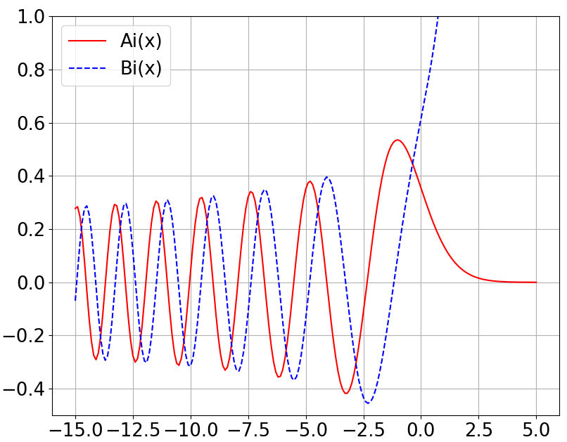
Hurkx TAT model: Linearly varying potential
$\left[H_{0}+V\left(r\right)\right]ψ=Eψ$
$$\left(−\frac{ℏ^{2}}{2m^{∗}}\frac{d^{2}}{dx^{2}}+qFx\right)φ=Eφ$$
$φ_{1}\left(R_{j}\right)≫φ_{n}\left(R_{j}\right)$, $n≠1$
$V_{jj^{′}}≈V\left(R_{j}\right)δ_{jj^{′}}$
$V\left(r\right)=qFx$ (not parabolic)
$E\left(k\right)≈{ℏ^{2}k^{2}}/{2m^{∗}}$
Let $u≡γ\left(x−x_{E}\right)$, where
$γ≡{\left(2m^{∗}qFℏ^{−2}\right)}^{1/3}$
$x_{E}≡E/qF$
$$\frac{d^{2}φ}{du^{2}}−uφ=0$$
$$φ=C_{1}Ai\left(u\right)+C_{2}Bi\left(u\right)$$
$$=C_{1}Ai\left[γ\left(x−x_{E}\right)\right]+C_{2}Bi\left[γ\left(x−x_{E}\right)\right]$$
$$∵\lim_{x→∞}{φ}=0, ∴C_{2}=0$$
$$∴φ=C_{1}Ai\left[γ\left(x−x_{E}\right)\right]≡φ_{E}$$

Slide 17
General SRH+TAT expression:
$$\frac{e_{n}}{e_{n0}}=\frac{n_{t}}{n}=1+Γ_{n}$$
$$R_{TAT+SRH}=\frac{np−n_{i}^{2}}{\frac{τ_{p}}{1+Γ_{p}}\left(n+n_{1}\right)+\frac{τ_{n}}{1+Γ_{n}}\left(p+p_{1}\right)}$$
$$R_{TAT+SRH}=N_{T}\frac{c_{n}c_{p}n_{t}p_{t}−e_{n}e_{p}}{c_{n}n_{t}+c_{p}p_{t}+e_{n}+e_{p}}$$
$$\frac{e_{p}}{e_{p0}}=\frac{p_{t}}{p}=1+Γ_{p}$$
$$≈{\left(1+Γ_{n=p}\right)R}_{SRH}$$
$$T_{E}\left(x\right)≡\frac{{\left|φ_{E}\left(x\right)\right|}^{2}}{{\left|φ_{E}\left(x_{E} \right)\right|}^{2}}=\frac{{Ai}^{2}\left[γ\left(x−x_{E}\right)\right]}{{Ai}^{2}\left(0\right)}$$
$$n_{t}\left(x\right)=\int_{E_{T}\left(x\right)}^{E_{c}\left(x\right)}{g\left(E\right)f\left(E\right)T_{E}\left(x\right)dE}+\int_{E_{c}\left(x\right)}^{∞}{g\left(E\right)f\left(E\right)dE}$$
$$E$$
$$=\int_{E_{T}\left(x\right)}^{E_{c}\left(x\right)}{\left(−\frac{dn}{dE}\right)T_{E}\left(x\right)dE}+n\left(x\right)$$
$$E_{c}\left(x\right)$$
$$E_{cp}$$
$$φ_{E}\left(x\right)$$
$$E_{cn}≡0$$
$$E_{T}\left(x\right)$$
$$=n\left(x\right)+\int_{δ}^{x}{{\left(−\frac{dn}{dx}\right)}_{x=x_{E}}\frac{{Ai}^{2}\left[γ\left(x−x_{E}\right)\right]}{{Ai}^{2}\left(0\right)}dx_{E}}$$
$$x$$
$$0$$
$$δ$$
$$x_{E}$$
$$x$$
$$∵{\left(−\frac{dn}{dx}\right)}_{x=x_{E}}=−{\frac{d}{dx}\left[n_{i}exp\left(\frac{E_{Fn}−E_{i}}{kT}\right)\right]}_{x=x_{E}}=n_{i}exp\left[\frac{E_{Fn}−E_{i}\left(x_{E}\right)}{kT}\right]\frac{qF}{kT}=n\left(x\right)\frac{qF}{kT}exp\left[\frac{E_{i}\left(x\right)−E_{i}\left(x_{E}\right)}{kT}\right]$$
$$∴n_{t}\left(x\right)=n\left(x\right)\left\{1+\frac{qF}{kT}\int_{δ}^{x}{exp\left[\frac{E_{i}−E_{i}\left(x_{E}\right)}{kT}\right]\frac{{Ai}^{2}\left[γ\left(x−x_{E}\right)\right]}{{Ai}^{2}\left(0\right)}dx_{E}}\right\}=n\left(x\right)\left\{1+\frac{1}{kT}\int_{E_{T}\left(x\right)}^{E_{c}\left(x\right)}{exp\left(\frac{E_{c}−E}{kT}\right)\frac{{Ai}^{2}\left[γ\left(x−x_{E}\right)\right]}{{Ai}^{2}\left(0\right)}dE}\right\}$$

Slide 18
$$E$$
$$E_{cp}$$
$$φ_{E}\left(x\right)$$
$$E_{c}\left(x\right)$$
$$\frac{n_{t}}{n}=1+\frac{1}{kT}\int_{E_{T}\left(x\right)}^{E_{c}\left(x\right)}{exp\left(\frac{E_{c}−E}{kT}\right)\frac{{Ai}^{2}\left[γ\left(x−x_{E}\right)\right]}{{Ai}^{2}\left(0\right)}dE}$$
$$E_{cn}≡0$$
$$E_{T}\left(x\right)$$
$$x$$
$$0$$
$$δ$$
$$x_{E}$$
$$x$$
$$e_{n}=\left(thermal emission\right)+\left(tunneling\right)$$
Is it plausible?
$$=e_{n}^{∞}exp\left(−\frac{E_{c}−E_{T}}{kT}\right)+\int_{E_{T}}^{E_{c}}{e_{n}^{∞}exp\left(−\frac{E′−E_{T}}{kT}\right)\frac{{Ai}^{2}\left[γ\left(x−x_{E^{′}}\right)\right]}{{Ai}^{2}\left(0\right)}d\left(\frac{E′}{kT}\right)}$$
$$E$$
$$E_{c}\left(x\right)$$
Let $E=qFx−E^{′}=E_{c}−E^{′}$,
$$e_{n}=e_{n}^{∞}exp\left(−\frac{E_{c}−E_{T}}{kT}\right)+e_{n}^{∞}\left(−\frac{E_{c}−E_{T}}{kT}\right)\frac{1}{kT}\int_{0}^{E_{c}−E_{T}}{exp\left(\frac{E}{kT}\right)\frac{{Ai}^{2}\left(2m^{∗}γ^{−2}ℏ^{−2}E\right)}{{Ai}^{2}\left(0\right)}dE}$$
$$P′′$$
$$E$$
$$P′$$
$$P$$
$$=e_{n}^{∞}exp\left(−\frac{E_{c}−E_{T}}{kT}\right)\left[1+\frac{1}{kT}\int_{0}^{E_{c}−E_{T}}{exp\left(\frac{E}{kT}\right)\frac{{Ai}^{2}\left(2m^{∗}γ^{−2}ℏ^{−2}E\right)}{{Ai}^{2}\left(0\right)}dE}\right]$$
$$E_{T}\left(x\right)$$
Phonon-assisted tunneling: $P′→P′′$
$$=e_{n0}\left[1+\frac{1}{kT}\int_{0}^{E_{c}−E_{T}}{exp\left(\frac{E}{kT}\right)\frac{{Ai}^{2}\left(2m^{∗}γ^{−2}ℏ^{−2}E\right)}{{Ai}^{2}\left(0\right)}dE}\right]$$

Slide 19
General SRH+TAT expression:
$$\frac{e_{n}}{e_{n0}}=\frac{n_{t}}{n}=1+Γ_{n}$$
$$R_{TAT+SRH}=\frac{np−n_{i}^{2}}{\frac{τ_{p}}{1+Γ_{p}}\left(n+n_{1}\right)+\frac{τ_{n}}{1+Γ_{n}}\left(p+p_{1}\right)}$$
$$R_{TAT+SRH}=N_{T}\frac{c_{n}c_{p}n_{t}p_{t}−e_{n}e_{p}}{c_{n}n_{t}+c_{p}p_{t}+e_{n}+e_{p}}$$
$$\frac{e_{p}}{e_{p0}}=\frac{p_{t}}{p}=1+Γ_{p}$$
$$≈{\left(1+Γ_{n=p}\right)R}_{SRH}$$
$$E$$
$$E_{cp}$$
Let $E=qFx−E^{′}=E_{c}−E^{′}$,
$$φ_{E}\left(x\right)$$
$$E_{c}\left(x\right)$$
$$\frac{n_{t}}{n}=1+\frac{1}{kT}\int_{E_{T}\left(x\right)}^{E_{c}\left(x\right)}{exp\left(\frac{E_{c}−E′}{kT}\right)\frac{{Ai}^{2}\left[γ\left(x−x_{E^{′}}\right)\right]}{{Ai}^{2}\left(0\right)}dE′}$$
$$E_{cn}≡0$$
$$E_{T}\left(x\right)$$
$$x$$
$$0$$
$$δ$$
$$x_{E}$$
$$x$$
$$=1+\frac{1}{kT}\int_{0}^{E_{c}−E_{T}}{exp\left(\frac{E}{kT}\right)\frac{{Ai}^{2}\left(2m^{∗}γ^{−2}ℏ^{−2}E\right)}{{Ai}^{2}\left(0\right)}dE}$$
$$E$$
$$E_{c}\left(x\right)$$
$$\frac{e_{n}}{e_{n0}} =1+\frac{1}{kT}\int_{0}^{E_{c}−E_{T}}{exp\left(\frac{E}{kT}\right)\frac{{Ai}^{2}\left(2m^{∗}γ^{−2}ℏ^{−2}E\right)}{{Ai}^{2}\left(0\right)}dE}$$
$$P′′$$
$$E$$
$$P′$$
$$∴\frac{e_{n}}{e_{n0}}=\frac{n_{t}}{n}=1+Γ_{n};{ Γ}_{n}≡\frac{1}{kT}\int_{0}^{E_{c}−E_{T}}{exp\left(\frac{E}{kT}\right)\frac{{Ai}^{2}\left(2m^{∗}γ^{−2}ℏ^{−2}E\right)}{{Ai}^{2}\left(0\right)}dE}$$
$$P$$
$$E_{T}\left(x\right)$$

Slide 20
$$Γ_{n}\sim \frac{E_{c}−E_{T}}{kT}\int_{0}^{1}{exp\left(\frac{E_{c}−E_{T}}{kT}u−K_{n}u^{3/2}\right)du}$$
$$Ai\left(y\right)\sim exp\left(−\frac{2}{3}y^{3/2}\right)$$
$$Γ_{n}≡\frac{1}{kT}\int_{0}^{E_{c}−E_{T}}{exp\left(\frac{E}{kT}\right)\frac{{Ai}^{2}\left(2m^{∗}γ^{−2}ℏ^{−2}E\right)}{{Ai}^{2}\left(0\right)}dE}$$
$$K_{n}≡\frac{4}{3}\frac{\sqrt{2m^{∗}{\left(E_{c}−E_{T}\right)}^{3}}}{qℏF}$$
For not too large field, e.g., at room temperature and for $E_{c}−E_{T}=0.5 eV$, $F<9×{10}^{5} V/cm$,
$$Γ≡Γ_{n}≈Γ_{p}≈2\sqrt{3π}\frac{\left|\overline{F}\right|}{F_{Γ}}exp\left[{\left(\frac{F}{F_{Γ}}\right)}^{2}\right],{ F}_{Γ}≡\frac{\sqrt{24m^{∗}{\left(kT\right)}^{3}}}{qℏ}$$
For uniform doping concentration, $N\left(x\right)=N_{D} when x_{1}<x<x_{2},$
$$I=AqG_{SRH}\int_{x_{1}}^{x_{2}}{\left(1+Γ\right)dx}=AqG_{SRH}\left(d+d_{TAT}\right),$$
$$d_{TAT}≡\int_{x_{1}}^{x_{2}}{Γ\left(x\right)dx}=\frac{\sqrt{3π}εF_{Γ}}{qN_{D}}\left\{exp\left[{\left(\frac{F_{2}}{F_{Γ}}\right)}^{2}\right]−exp\left[{\left(\frac{F_{1}}{F_{Γ}}\right)}^{2}\right]\right\},$$
$$F_{1,2}≡F\left(x_{1,2}\right)$$
In sum,
$$I=Aq\sqrt{N_{c300}N_{v300}}{\left(\frac{T}{300}\right)}^{3/2}exp\left[−\frac{E_{g}\left(T\right)}{2kT}\right]{\left[2\sqrt{τ_{p}τ_{n}}\cosh\left(\frac{E_{T}−E_{i}}{kT}+\frac{1}{2}\text{ln}\frac{τ_{p}}{τ_{n}}\right)\right]}^{−1}\left\{d+\frac{\sqrt{3π}εF_{Γ}}{qN_{D}}\left\{exp\left[{\left(\frac{F_{2}}{F_{Γ}}\right)}^{2}\right]−exp\left[{\left(\frac{F_{1}}{F_{Γ}}\right)}^{2}\right]\right\}\right\}$$

Slide 21
Validity of Hurkx trap-assisted tunneling model
$\left[H_{0}+V\left(r\right)\right]ψ=Eψ$
$φ_{1}\left(R_{j}\right)≫φ_{n}\left(R_{j}\right)$, $n≠1$
$V_{jj^{′}}≈V\left(R_{j}\right)δ_{jj^{′}}$
$V\left(r\right)=qFx$ (not parabolic)
$E\left(k\right)≈{ℏ^{2}k^{2}}/{2m^{∗}}$
$$\left(−\frac{ℏ^{2}}{2m^{∗}}\frac{d^{2}}{dx^{2}}+qFx\right)φ=Eφ$$
Single-band approximation
Spherical & parabolic band approximation
$$E_{n}\left(−i∇\right)φ_{n}\left(r\right)+V\left(r\right)φ_{n}\left(r\right)+\sum_{n^{′}\left(≠n\right)}{V_{nn^{′}}φ_{n^{′}}\left(r\right)}=Eφ_{n}\left(r\right)$$
因為 InP 的 $Γ$ valley 質量並不大，以及InP 電場特別高，所以電子很容易有高能量，也就容易產生 intervalley scattering，使得上述近似並不適用於 InP。而即便僅有 intravalley scattering，這時也必須考慮能帶的 nonparabolicity，使得等效質量之 Hamiltonian $E\left(−i∇\right)+V$ 將十分複雜。而 InGaAs 之電場較小，所以應該較適合 spherical & parabolic band。
$$E_{c}\left(−i∇\right)φ_{c}\left(r\right)+V\left(r\right)φ_{c}\left(r\right)+0=Eφ_{c}\left(r\right)$$
$$E_{v}\left(−i∇\right)φ_{v}\left(r\right)+V\left(r\right)φ_{v}\left(r\right)+V_{cv}φ_{v}\left(r\right)=Eφ_{v}\left(r\right)$$
$$\left|φ_{v}\left(r\right)\right|\sim \frac{V_{cv}}{E_{g}}\left|φ_{c}\left(r\right)\right|<\left|\frac{E}{E_{g}}\right|\left|φ_{c}\left(r\right)\right|≈\left|\frac{V_{applied}}{E_{g}}\right|\left|φ_{c}\left(r\right)\right|$$

Slide 22
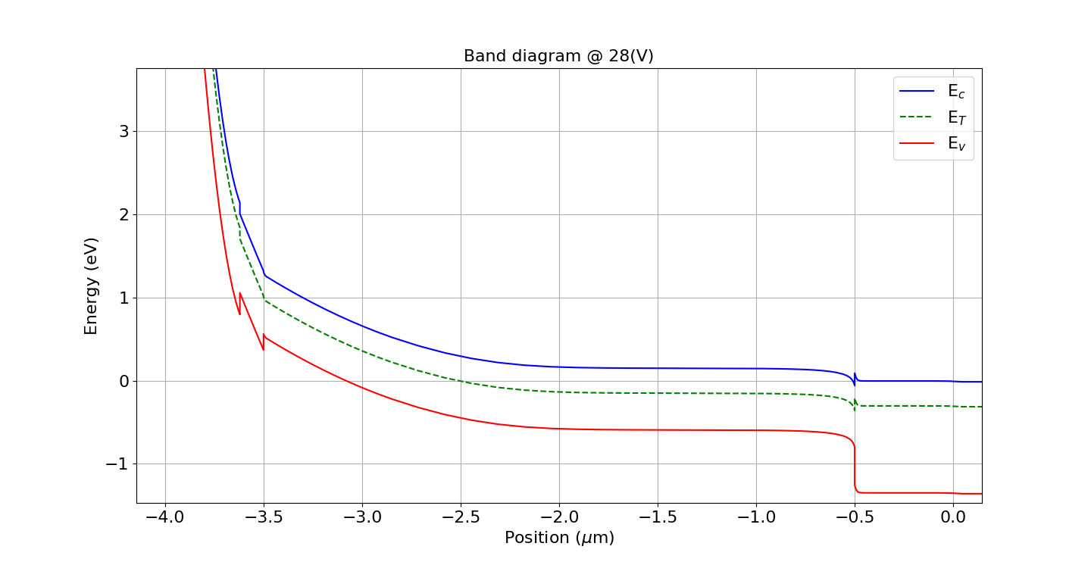
InGaAs
$$E\left(x\right)$$
EMA confident interval
$$E_{g}$$
$$0.5 E_{g}$$
$$x$$
$$−0.5E_{g}$$
$$\left|φ_{v}\left(r\right)\right|\sim \frac{V_{cv}}{E_{g}}\left|φ_{c}\left(r\right)\right|<\left|\frac{E}{E_{g}}\right|\left|φ_{c}\left(r\right)\right|≈\left|\frac{V_{applied}}{E_{g}}\right|\left|φ_{c}\left(r\right)\right|$$

Slide 23
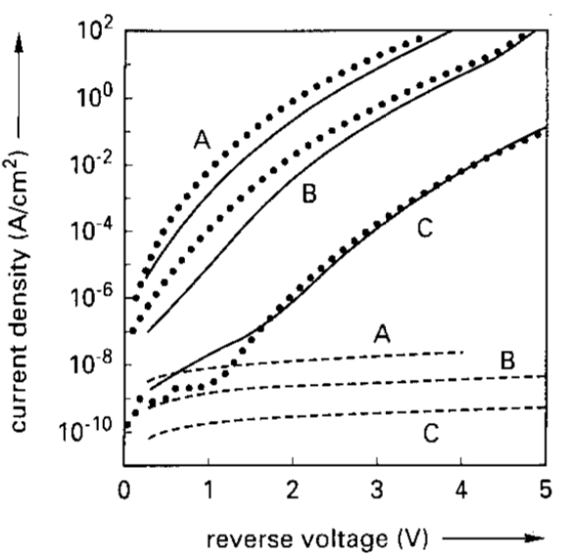
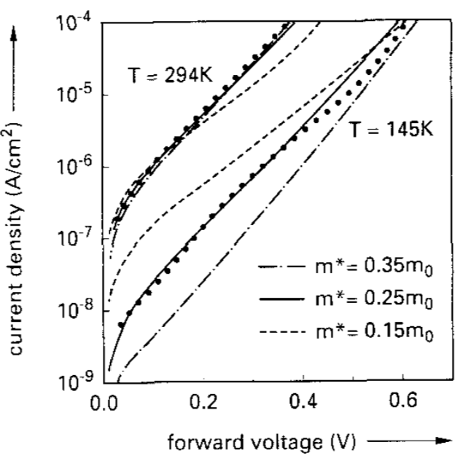

Slide 24
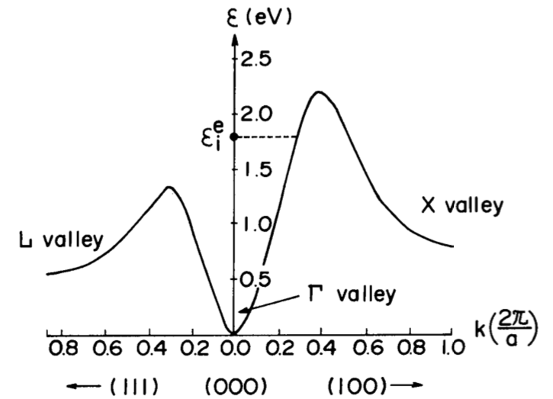
Band structure
 | $Γ$ valley | $L$ valley | $X$ valley
# of valleys | 1 | 4 | 3
Nonparabolicity | 1.0 | 0.4 | 0.5
Effective mass | 0.08
longitudinal |  | 0.95 | 0.9
transverse |  | 0.32 | 0.3
Valley separation |  | 0.54 | 0.78
InGaAs:
$\left(000\right) Γ$ valley: $ε\left(1+0.576ε\right)=\frac{ℏ^{2}k^{2}}{2\left(0.067m_{e}\right)}$
$\left(000\right) Γ$ valley: $ε\left(1+γ_{Γ}ε\right)=\frac{ℏ^{2}k^{2}}{2m_{Γ}}$
$\left(111\right) L$ valley: $\left(ε−∆ε_{ΓL}\right)\left[1+γ_{L}\left(ε−∆ε_{ΓL}\right)\right]$
$=\frac{ℏ^{2}}{6m_{Ll}}{\left(\frac{3π}{a}−k_{x}−k_{y}−k_{z}\right)}^{2}$
InP
$+\frac{ℏ^{2}}{3m_{Lt}}\left(k_{x}^{2}+k_{y}^{2}+k_{z}^{2}−k_{x}k_{y}−k_{y}k_{z}−k_{z}k_{x}\right)$
$\left(100\right) X$ valley: $\left(ε−∆ε_{ΓX}\right)\left[1+γ_{X}\left(ε−∆ε_{ΓX}\right)\right]$
$=\frac{ℏ^{2}}{2m_{Xl}}{\left(\frac{2π}{a}−k_{x}\right)}^{2}+\frac{ℏ^{2}}{2m_{Xt}}\left(k_{x}^{2}+k_{y}^{2}\right)$

Slide 25
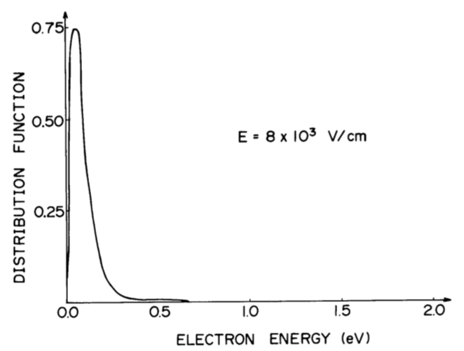
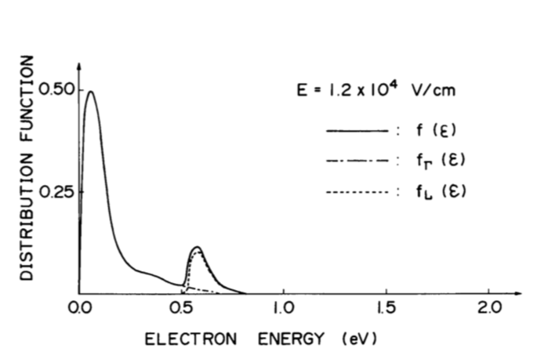
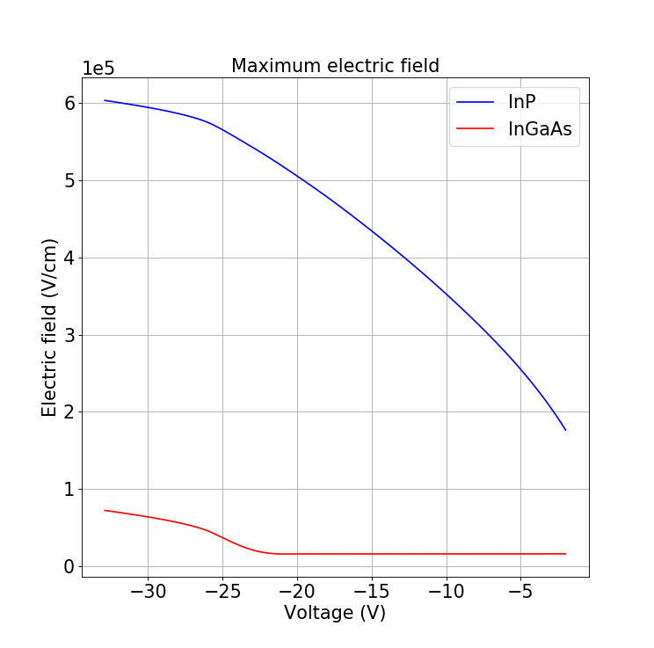
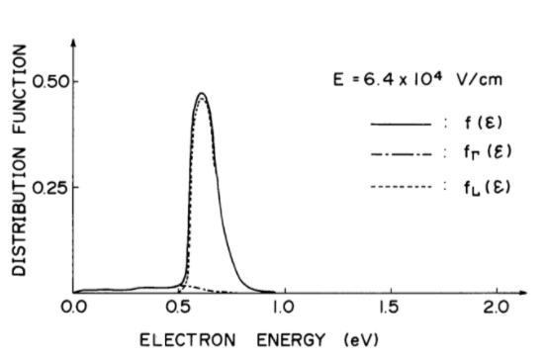
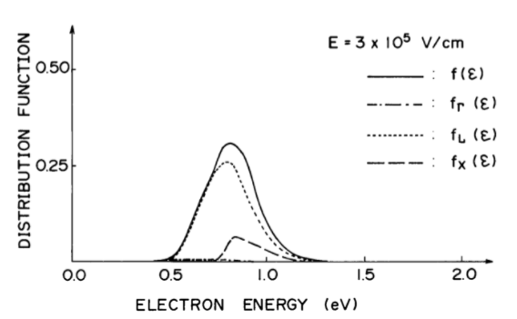

Slide 26
Curve fitting method
$$I=Aq\sqrt{N_{c300}N_{v300}}{\left(\frac{T}{300}\right)}^{3/2}exp\left[−\frac{E_{g}\left(T\right)}{2kT}\right]{\left[2\sqrt{τ_{p}τ_{n}}\cosh\left(\frac{E_{T}−E_{i}}{kT}+\frac{1}{2}\text{ln}\frac{τ_{p}}{τ_{n}}\right)\right]}^{−1}\left\{d+\frac{\sqrt{3π}εF_{Γ}}{qN_{D}}\left\{exp\left[{\left(\frac{F_{2}}{F_{Γ}}\right)}^{2}\right]−exp\left[{\left(\frac{F_{1}}{F_{Γ}}\right)}^{2}\right]\right\}\right\}$$
Setting TCAD Doping Profile
Zn diffusion
Distribution
InP maximum field
Least square method
Find best trap level, effective mass and lifetime
Charge layer
InGaAs maximum field
Depletion width
$${ F}_{Γ}≡\frac{\sqrt{24m^{∗}{\left(kT\right)}^{3}}}{qℏ}$$
$$I=I_{T}\left(V, E_{Ti}, m^{∗},τ_{p},τ_{n}\right);$$

Slide 27
Fitting results
2 Doping profiles ($d_{InGaAs, charge}=0$ or $d_{InGaAs, charge}≠0$)
IV, trap, effective mass and lifetime results
Large bias range & $d_{InGaAs, charge}=0$
Small bias range & $d_{InGaAs, charge}=0$
Large bias range & $d_{InGaAs, charge}≠0$
Small bias range & $d_{InGaAs, charge}≠0$

Slide 28
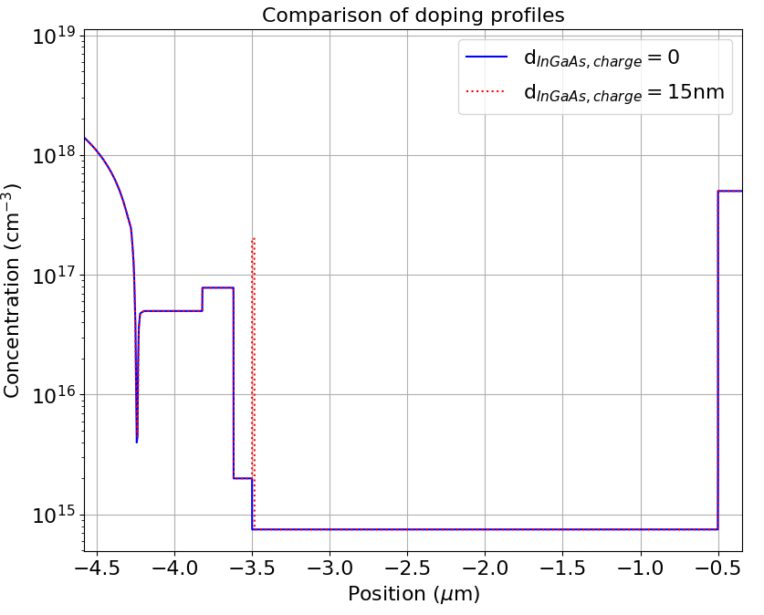
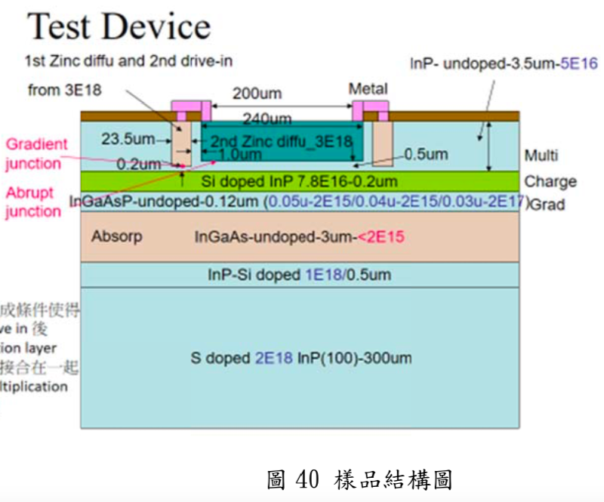
$$I=Aq\sqrt{N_{c300}N_{v300}}{\left(\frac{T}{300}\right)}^{3/2}exp\left[−\frac{E_{g}\left(T\right)}{2kT}\right]{\left[2\sqrt{τ_{p}τ_{n}}\cosh\left(\frac{E_{T}−E_{i}}{kT}+\frac{1}{2}\text{ln}\frac{τ_{p}}{τ_{n}}\right)\right]}^{−1}\left\{d+\frac{\sqrt{3π}εF_{Γ}}{qN_{D}}\left\{exp\left[{\left(\frac{F_{2}}{F_{Γ}}\right)}^{2}\right]−exp\left[{\left(\frac{F_{1}}{F_{Γ}}\right)}^{2}\right]\right\}\right\}$$
游朝政論文內容截圖
2e17
7.8e16
Multiplication layer: 0.42 μm
Charge layer: 0.2 μm
Grading layer: 0.12 μm
Absorption layer: 3 μm
5e16
2e15
7.5e14

Slide 29
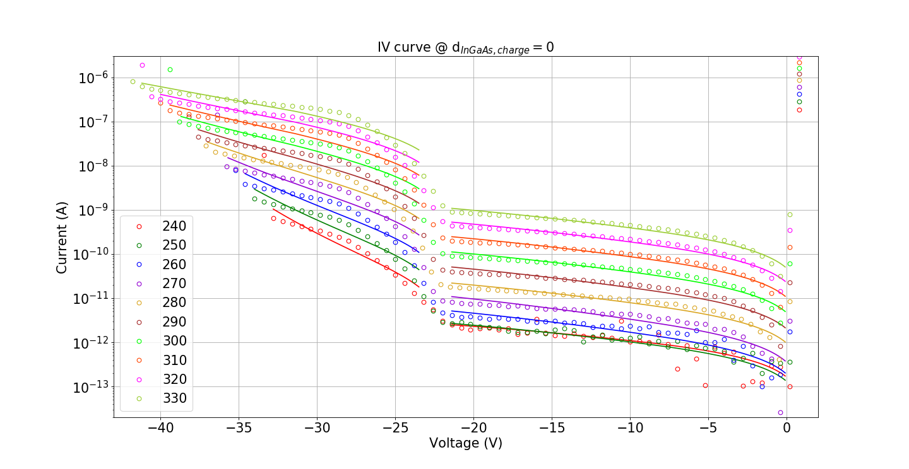
0917/IV_fitting.py

Slide 30
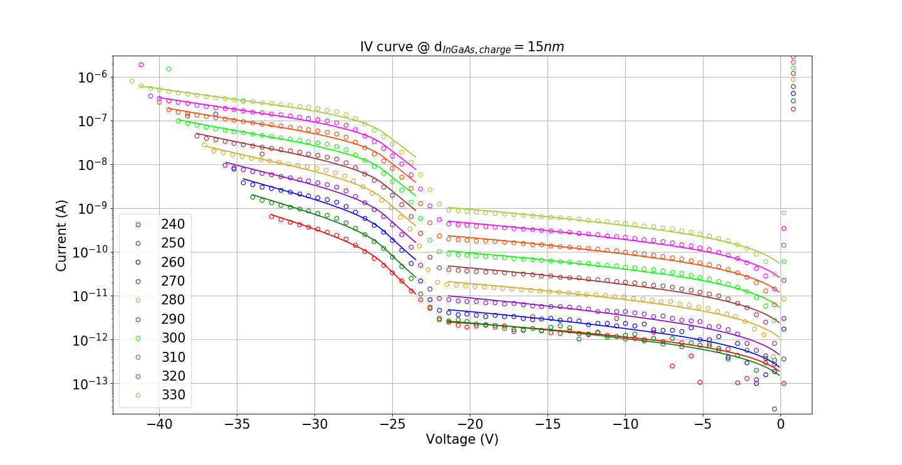
0917/IV_ABthick1.py

Slide 31
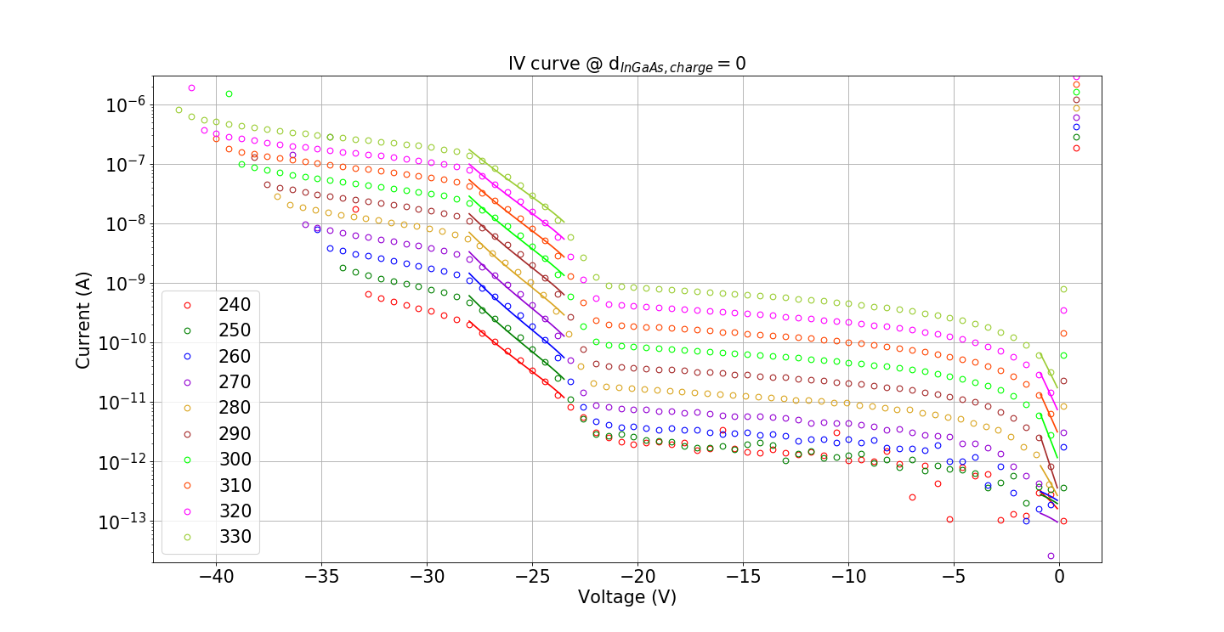
0917/IV_fitting.py

Slide 32
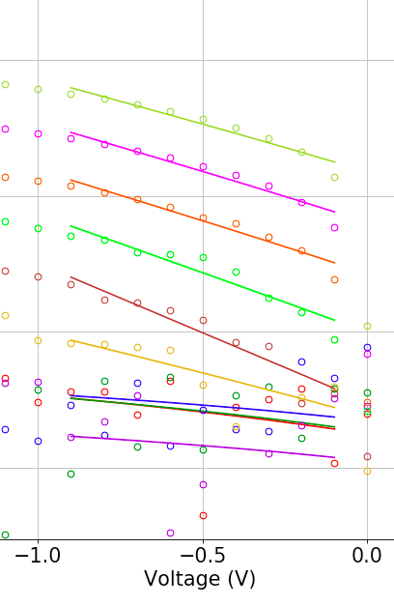
0917/IV_ABthick1_beta.py

Slide 33
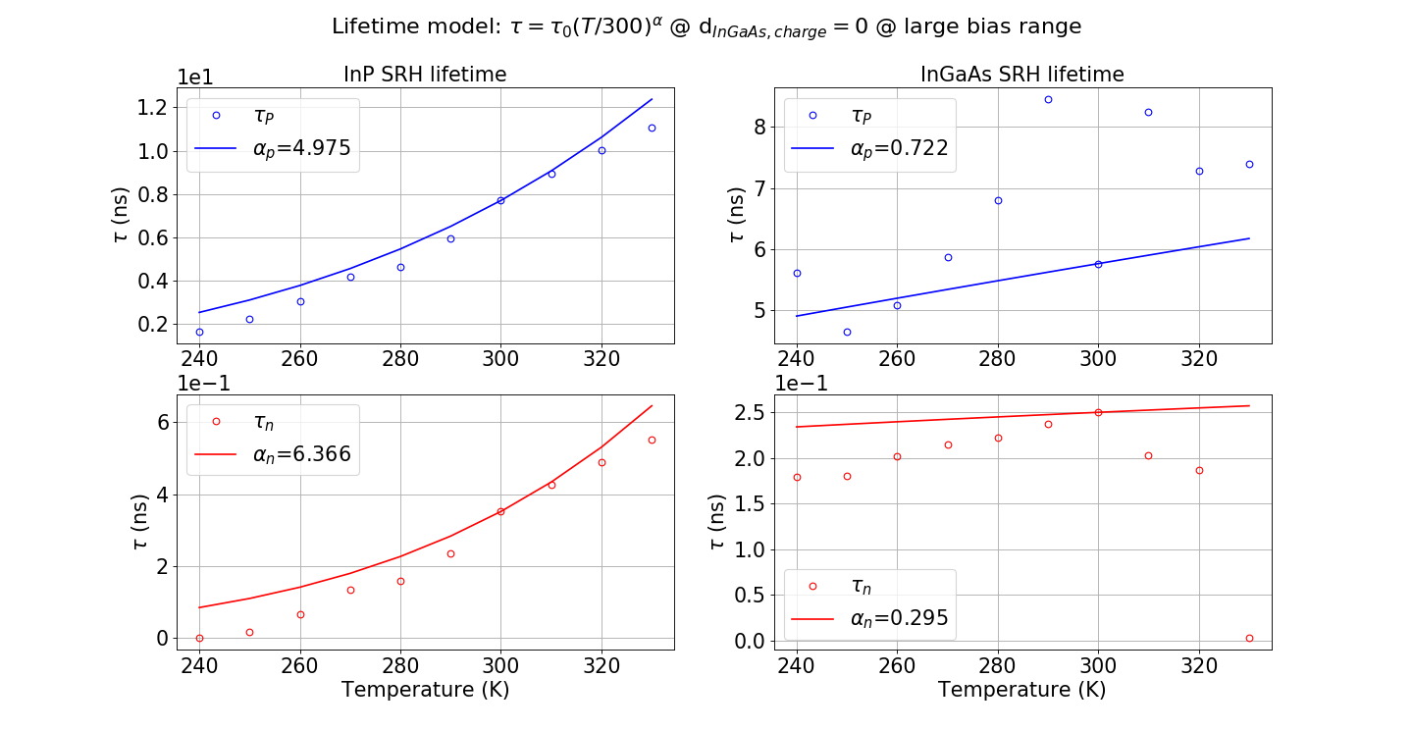
0917/IV_fitting.py

Slide 34
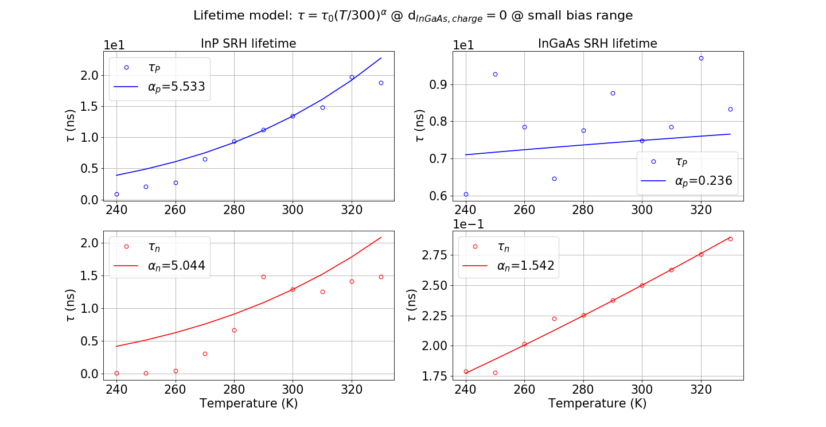
0917/IV_fitting.py

Slide 35
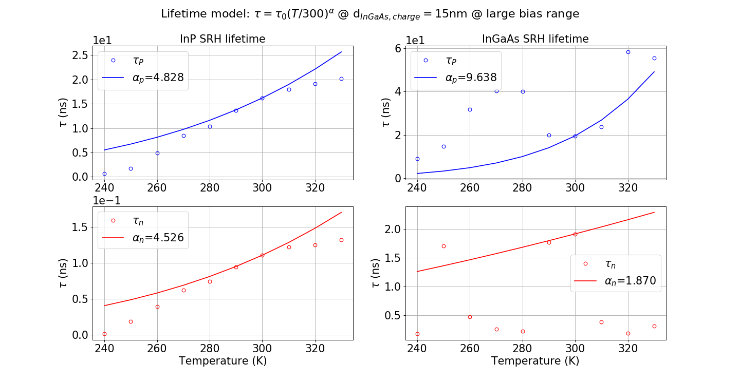
0917/IV_ABthick1.py

Slide 36
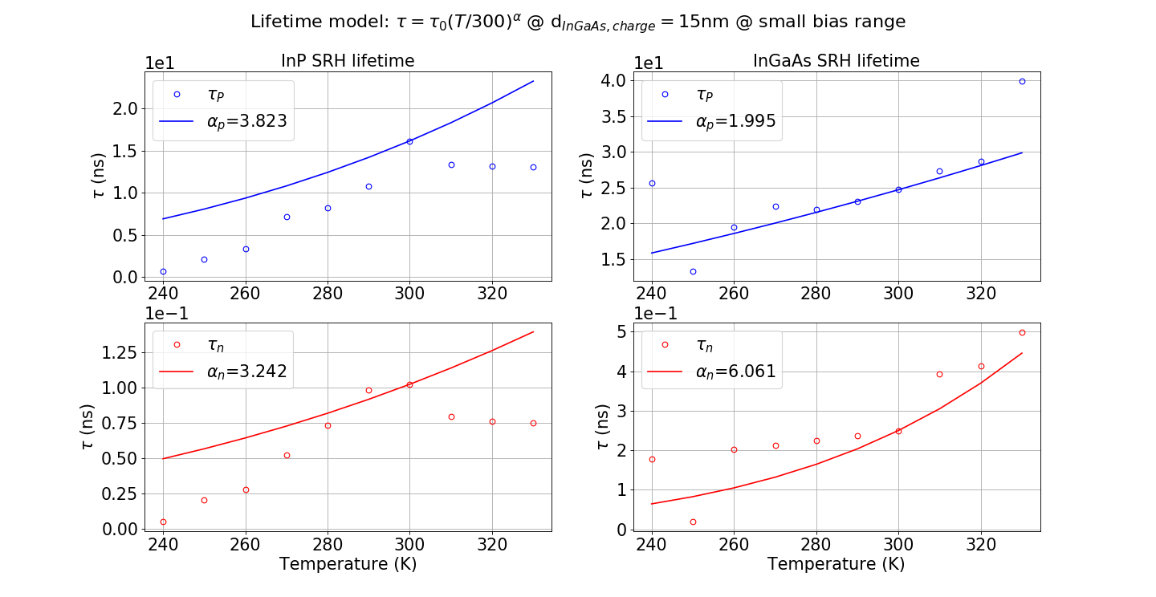
0917/IV_ABthick1_beta.py

Slide 37
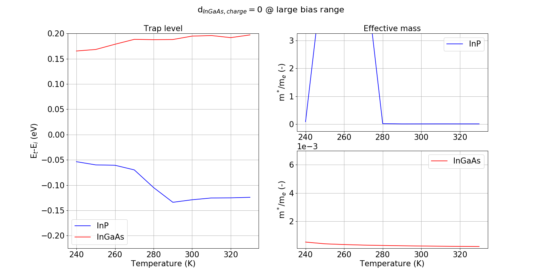
0917/IV_fitting.py

Slide 38
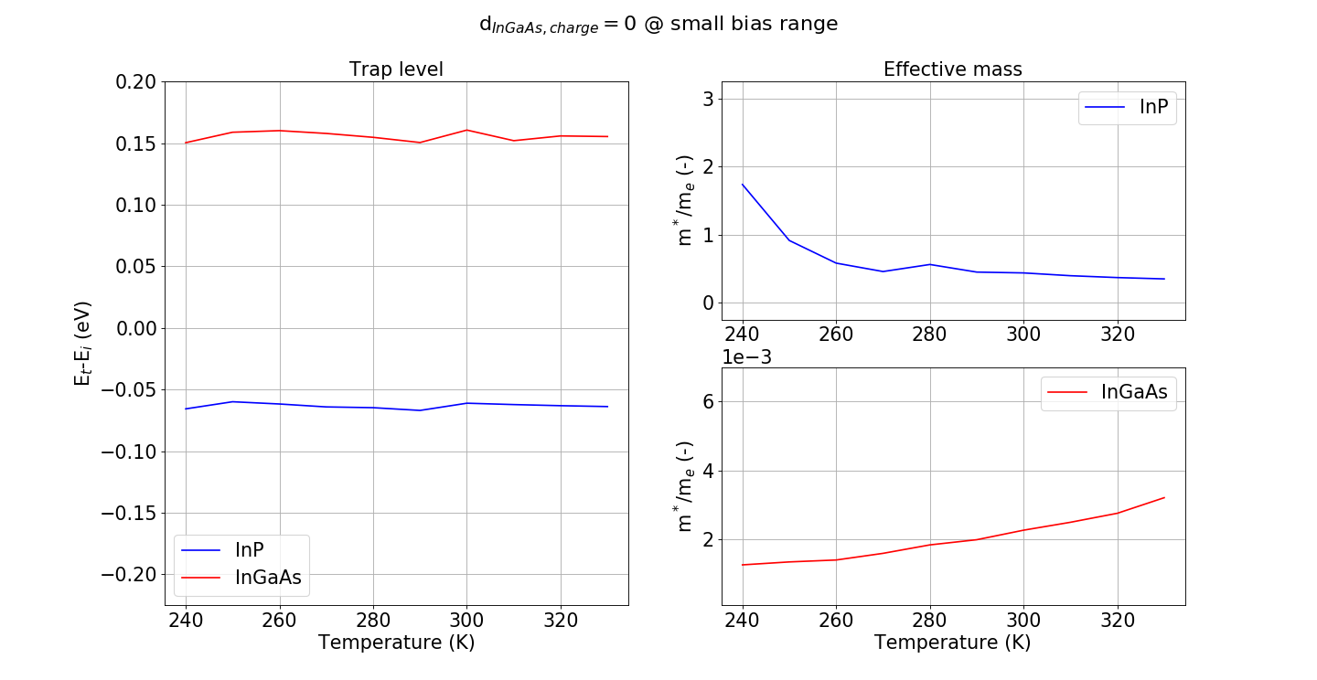
0917/IV_fitting.py

Slide 39
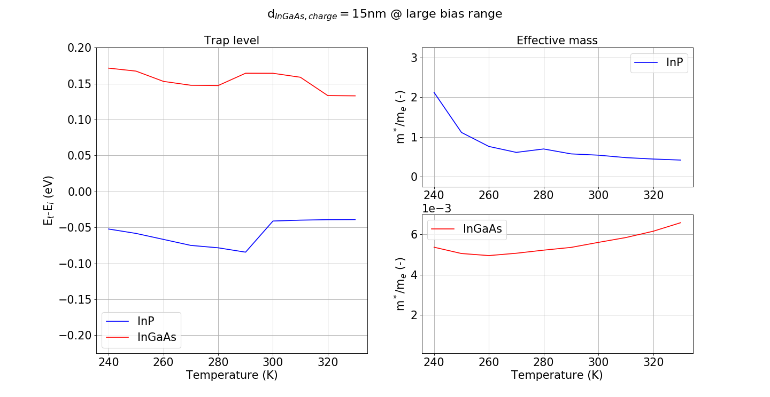
0917/IV_ABthick1.py

Slide 40
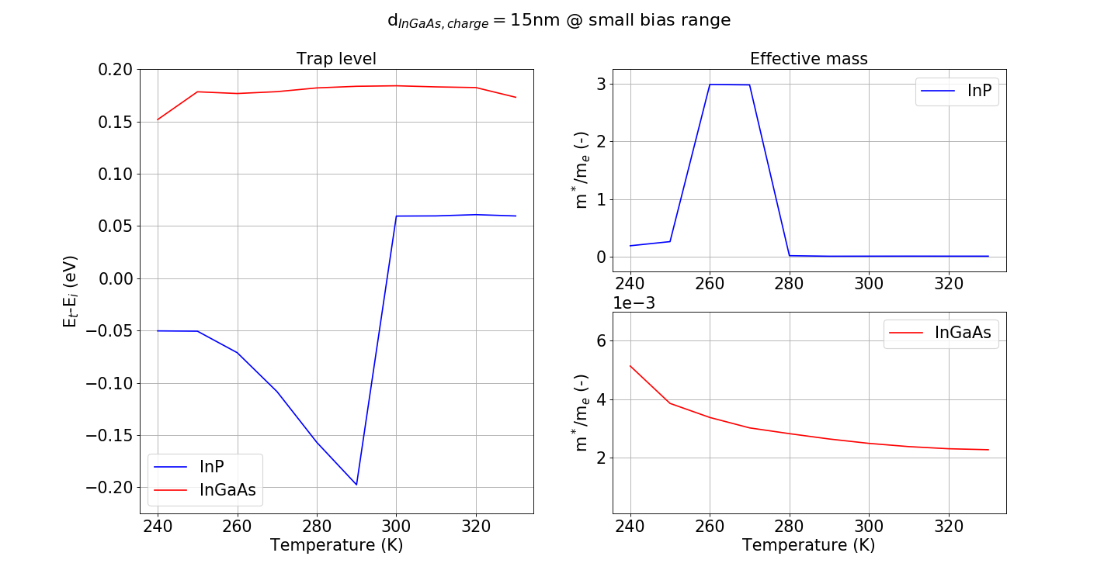
0917/IV_ABthick1_beta.py

Slide 41
Discussions
Why do we rule out SRH without trap-assisted tunneling?
Validity of effective-mass approximation
Dependence of effective mass, lifetime and trap level
Doping effects
Uncertainty effect of grading layer concentration ($n_{i}$)
Depletion width and equivalent depletion width distribution
Overestimation of Hurkx trap-assisted tunneling when $V>≈V_{pt}$

Slide 42
Assumptions about device parameters
$n_{i,InP}=$

